Slide 1

UNMASKING DECEPTION: FAKE DETECTION USING NEWS ARTICLE ANALYSIS
Group-5
Abinaya Sundari Panneerselvam
Harish Kumar Uddandi
Bharath Bhimireddy

Slide 2
Project Scope
Develop comprehensive fake news detection system.
Focus on political landscapes' susceptibility to manipulation.
Leverage advanced NLP algorithms and machine learning.
Identify deceptive content beyond surface-level analysis.

Slide 3
Dataset
Dataset source – Kaggle: https://www.kaggle.com/c/fake-news/data
ID, Title, Author, Text, Label
Label 1 - Unreliable
Label 0 - Reliable

Slide 4
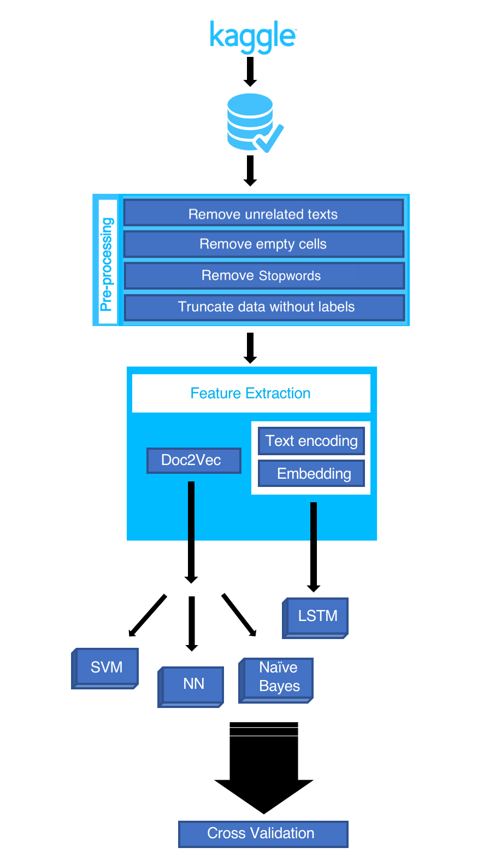
Data Workflow

Slide 5
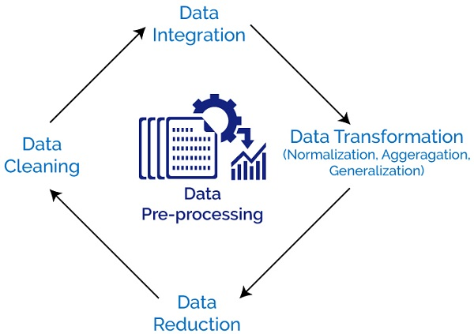
Data Preprocessing
Execute different text cleaning procedures. (delete stop words, remove all non-alphanumeric characters, delete missing rows, etc.)
Convert Doc2Vec to LabeledSentences(), comma separated word format.

Slide 6
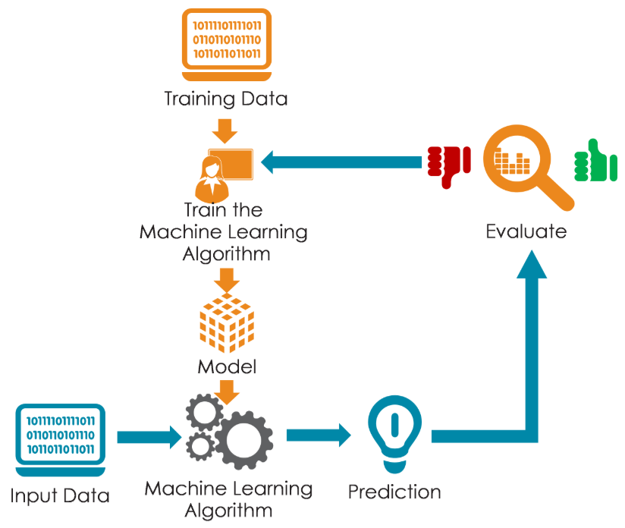
Models
Models used are:
Naive Bayes.
Support Vector Machine(SVM).
Neural Network.
Long Short-Term Memory(LSTM).

Slide 7
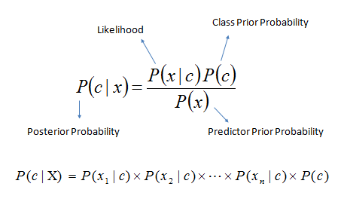
Naive Bayes Model
Classification strategy based on Naive Bayes' theorem and the assumption of predictor independence
Create a frequency table from the data collection.
Make a likelihood table by calculating probabilities.
Calculate the posterior probability for each class using the Naive Bayesian equation.

Slide 8
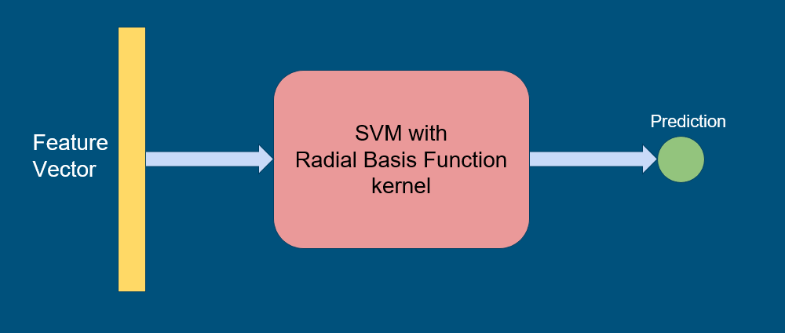
Support Vector Machine
Powerful model for classification tasks.
Seeks optimal hyperplane to separate classes or approximate regression function.
Handles high-dimensional data effectively.
Works with both linear and non-linear relationships.
Addresses class imbalance challenges well.
Requires careful selection of hyperparameters.
Computationally intensive in some cases.

Slide 9
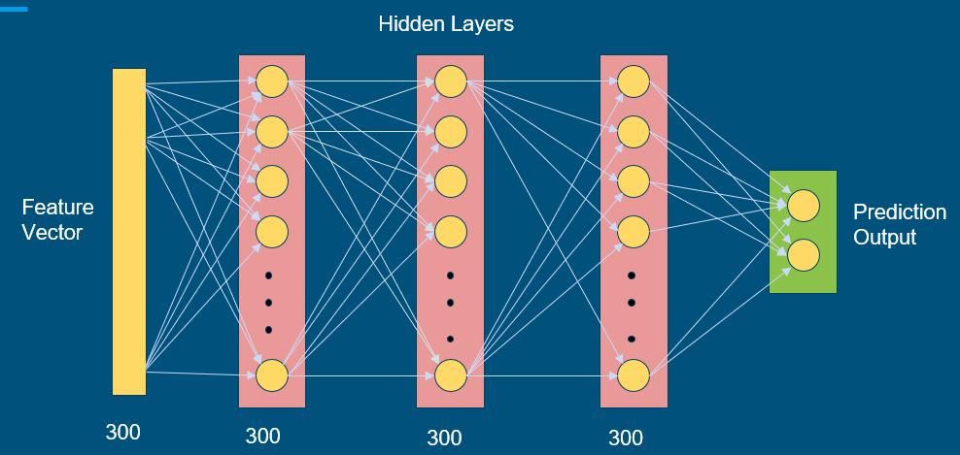
Neural Networks
Neural networks, especially deep learning models, are widely used across domains.
Excel in capturing intricate patterns and relationships in data.
Effective for handling high-dimensional data.
Proficient at capturing complex non-linear relationships.
Demands substantial labeled training data.
Requires significant computational resources for training.
Architecture design is critical for optimal performance.
Hyperparameter tuning is necessary to enhance model accuracy.
Regularization techniques are crucial for preventing overfitting.

Slide 10
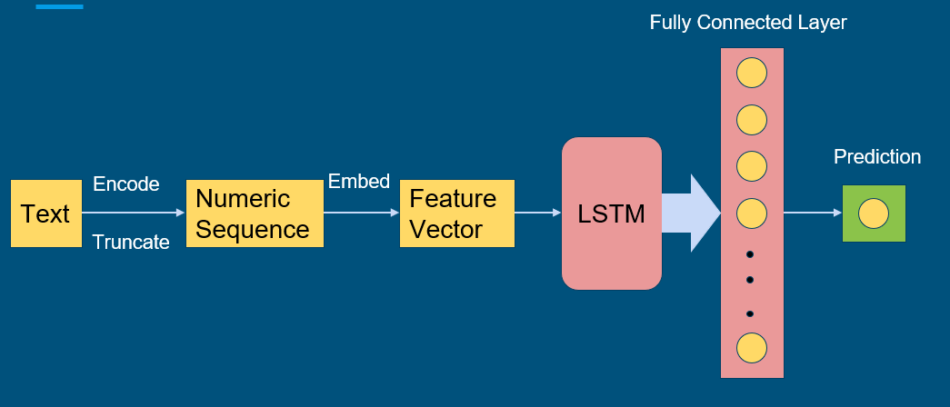
LSTM
Designed for sequential data like text or time series
Effective at capturing long-term dependencies and patterns
Suitable for text analysis tasks due to their capability
May incur high computational costs
Demand meticulous hyperparameter tuning
Prone to potential overfitting challenges

Slide 11
Accuracy Of Models
Model | Accuracy
Naive Bayes | 75.96%
SVM | 86.87%
Neural Network with TF | 83.58%
Neural Network with Keras | 92.68%
LSTM | 96.76%

Slide 12
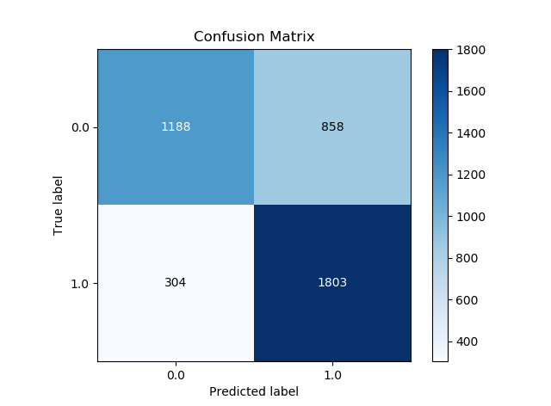
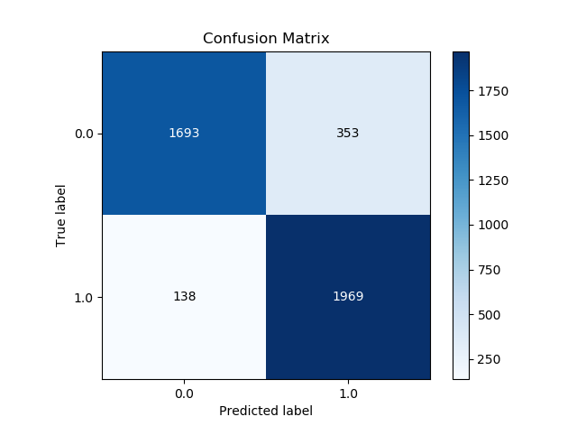
Confusion Matrices
Naive Bayes
SVM

Slide 13
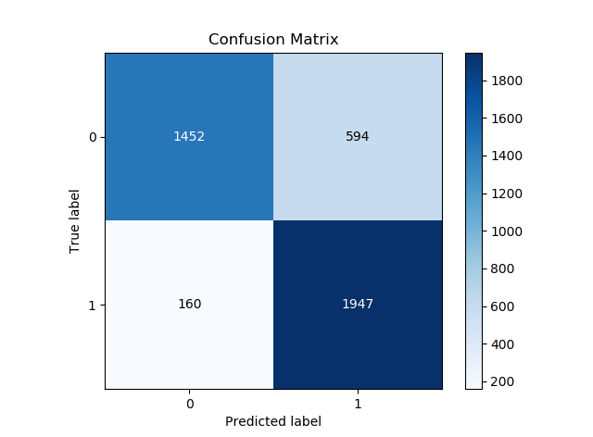
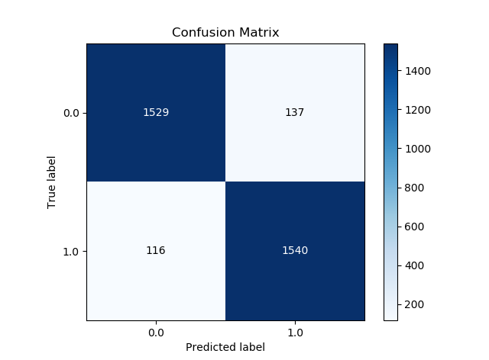
Confusion Matrices
Neural Network-Tensor Flow
Neural Network- Keras

Slide 14
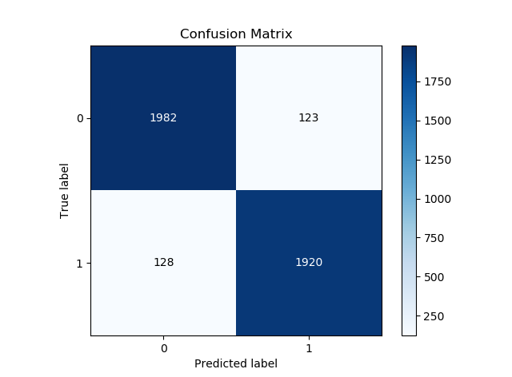
Confusion Matrices
LSTM

Slide 15

Limitations
The need for clean data to work directly with slowed down our progress.
The loss of information value in a real news scenario is very high.
Content-based classification is only a piece of the puzzle.
Distinguish between clickbait and actual fake news.

Slide 16
Future Work
Assemble the classifiers to achieve better performance - Adam Boost.
Check the sources of the news.
Search the news on the web to check the content of the news.

Slide 17
Thank You

